Slide 1


Employment Practices Liability Insurance (EPLI)

Slide 2

Introduction to EPLI
What is EPLI?
A specialized type of insurance that protects employers against claims made by employees alleging violations of their legal rights as workers.
Covers legal costs, settlements, and judgments related to employment practices.
What EPLI Covers: Legal costs, settlements, and judgments, whether the company wins or loses the case.
Notes:
EPLI is critical for businesses of all sizes due to the rising number of employee lawsuits. For example, in 2022, a small tech company with just 50 employees faced a costly lawsuit over wrongful termination. This case demonstrates that no business is too small to require EPLI coverage.

Slide 3
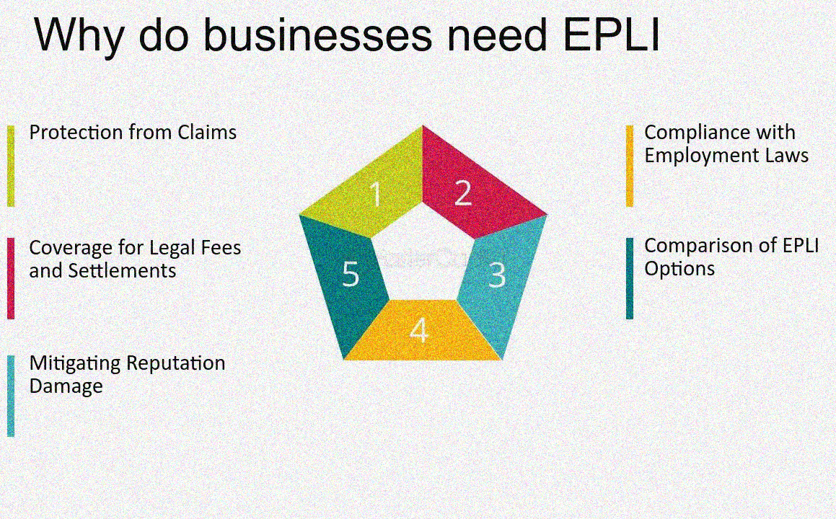

Slide 4

EPLI Coverage Options
Standalone Policy vs. Endorsement:
Standalone: A separate insurance policy specifically dedicated to covering employment practices liability.
Endorsement: An add-on to an existing Businessowners Policy (BOP) that extends coverage to include employment practices liability.
Notes:
Standalone EPLI Policy: A standalone EPLI policy is a dedicated insurance product that exclusively covers employment practices liability risks. This type of policy is typically more comprehensive, offering higher limits of coverage, and it may include broader terms and conditions tailored to the specific risks associated with employment practices.
Example: A large corporation with thousands of employees might opt for a standalone EPLI policy to ensure extensive protection against a wide range of employment-related claims, such as wrongful termination, harassment, and discrimination. Due to the size and complexity of the business, a standalone policy provides the flexibility and depth of coverage needed to address the various legal risks associated with managing a large workforce.
Endorsement to a BOP: An EPLI endorsement is an add-on to an existing Businessowners Policy (BOP), which is a bundled policy that typically covers general liability, property, and business interruption insurance. Adding EPLI as an endorsement to a BOP is usually more cost-effective, especially for small to mid-sized businesses, but it may offer more limited coverage compared to a standalone policy. The endorsement modifies the BOP to include employment practices liability coverage, but the limits and terms may be less extensive than those in a standalone policy.
Example: A small retail chain with several locations decided to add EPLI as an endorsement to their existing BOP after facing a couple of discrimination claims. By doing so, they were able to secure the necessary protection at a lower cost than if they had purchased a standalone policy. While the endorsement provided sufficient coverage for their specific needs, it was a more budget-friendly option, considering the size and risk profile of the business.
Comparison and Decision-Making: The decision between a standalone policy and an endorsement often depends on the size, complexity, and specific risks of the business. Larger businesses with higher exposure to employment-related claims might benefit from the comprehensive coverage of a standalone policy, while smaller businesses may find an endorsement to their BOP to be more practical and cost-effective.

Slide 5

EPLI Coverages
Sexual Harassment: Protection against claims of inappropriate behavior or harassment.
Discrimination: Covers allegations of bias based on race, gender, age, etc.
Wrongful Termination: Protection against claims of unjust firing.
Breach of Employment Contract: Coverage for claims that employment agreements were violated.
Negligent Evaluation: Claims related to unfair or biased employee evaluations.
Failure to Employ or Promote: Protection against claims of unfair hiring or promotion practices.
Wrongful Discipline: Coverage for claims of unjust disciplinary actions.
Deprivation of Career Opportunity: Claims related to denying career advancement opportunities.
Wrongful Infliction of Emotional Distress: Protection against claims of causing undue emotional harm.
Mismanagement of Employee Benefit Plans: Coverage for claims of improper handling of employee benefits.
Notes:
Sexual Harassment: EPLI protects against claims of sexual harassment, which might include unwanted advances, inappropriate comments, or other forms of harassment.
Example: A high-profile tech company faced a lawsuit from an employee who claimed persistent sexual harassment by a manager. The company's EPLI policy covered legal defense costs and the settlement, which totaled over $1 million.
Discrimination: This coverage addresses allegations of discrimination based on race, gender, age, religion, disability, or other protected characteristics.
Example: A retail store chain was sued by an employee who alleged that they were passed over for promotion due to their age. The EPLI policy covered the lawsuit costs and a $300,000 settlement.
Wrongful Termination: EPLI offers protection against claims that an employee was unjustly or unlawfully terminated from their position.
Example: A restaurant chain was sued for wrongful termination by an employee who claimed they were fired without proper cause. The EPLI policy covered the legal fees and an eventual settlement of $250,000.
Breach of Employment Contract: This covers claims that an employer failed to fulfill the terms of an employment agreement or contract.
Example: A marketing firm was taken to court by a former executive who alleged that the company violated the terms of his contract when they terminated him without severance. The EPLI policy covered the legal defense costs.
Negligent Evaluation: Protection against claims related to unfair, biased, or inaccurate performance evaluations.
Example: An employee sued their company after receiving a negative performance review, claiming it was biased and led to a missed promotion. The EPLI policy provided coverage for the defense and a small settlement.
Failure to Employ or Promote: Covers claims of unfair hiring practices or failure to promote employees based on merit.
Example: A female employee filed a lawsuit alleging gender discrimination after being passed over for promotion in favor of a less qualified male colleague. The EPLI policy covered legal costs and a settlement.
Wrongful Discipline: Coverage for claims that an employee was disciplined unjustly or unfairly.
Example: A company faced a lawsuit from an employee who was disciplined for insubordination, which they claimed was unjustified and discriminatory. The EPLI policy covered legal fees and damages.
Deprivation of Career Opportunity: Protects against claims that an employer prevented an employee from advancing in their career.
Example: An engineer sued their employer for denying them a promotion and career development opportunities, claiming favoritism and bias. The EPLI policy covered the lawsuit and a settlement agreement.
Wrongful Infliction of Emotional Distress: Covers claims of causing undue emotional harm through workplace actions or conditions.
Example: An employee claimed that constant harassment by their supervisor caused them significant emotional distress, leading to a lawsuit. The EPLI policy covered the legal expenses and a settlement.
Mismanagement of Employee Benefit Plans: Protection against claims of improper handling or mismanagement of employee benefits, such as retirement plans or health insurance.
Example: A lawsuit was filed by employees who alleged that their employer mismanaged the company’s 401(k) plan, leading to financial losses. The EPLI policy provided coverage for legal defense and a resolution of the claims.

Slide 6




Common EPLI Exclusions
Criminal Acts: No coverage for claims involving intentional or criminal acts by the employer.
Fines and Penalties: Excludes coverage for civil or criminal fines and penalties.
Bodily Injury and Property Damage: EPLI does not cover physical injuries or property damage (usually covered by general liability insurance).
Worker’s Compensation Claims: Excludes claims covered under worker's compensation policies.
Prior Acts or Known Claims: Claims arising from incidents that occurred before the policy’s effective date or were known before coverage was obtained.
Notes:
Criminal Acts: EPLI policies exclude coverage for claims involving intentional wrongdoing or criminal acts by the employer or its representatives. This is because insurance is generally intended to cover unforeseen or accidental events, not deliberate misconduct.
Example: A company CEO was found guilty of embezzling funds from the business. When employees filed a lawsuit against the company, claiming damages for the loss of their pensions, the EPLI policy did not cover the claims because they were tied to intentional criminal acts.
Fines and Penalties: EPLI does not cover civil or criminal fines and penalties imposed on a company or its executives. These are considered punitive in nature, and insurance policies typically exclude coverage for punitive measures to prevent moral hazard. Example: A manufacturing company faced fines from a regulatory body for violating workplace safety laws. The company's EPLI policy did not cover these fines, as they were classified as penalties rather than damages from a lawsuit.
Bodily Injury and Property Damage: EPLI specifically excludes coverage for claims involving physical injuries or property damage, as these are generally covered under other types of insurance, like general liability or worker’s compensation.
Example: A warehouse employee was injured on the job due to unsafe working conditions. The employee’s lawsuit was covered under the company’s general liability insurance, not the EPLI policy, which only covers employment-related claims such as discrimination or harassment.
Worker’s Compensation Claims: Claims that fall under worker's compensation are excluded from EPLI coverage because worker’s compensation is designed to handle work-related injuries or illnesses, while EPLI covers employment-related legal issues like wrongful termination or discrimination.
Example: An employee injured while lifting heavy equipment at work filed a worker's compensation claim. This claim was covered under the company’s worker’s compensation insurance, not the EPLI policy.
Prior Acts or Known Claims: EPLI excludes claims related to incidents that occurred before the policy's effective date or that were known before the policy was purchased. This prevents companies from purchasing coverage after an incident has already occurred.
Example: A marketing firm discovered a discrimination issue before purchasing their EPLI policy. When a lawsuit was filed after the policy was in place, the insurer denied the claim because the incident occurred before the policy’s effective date.

Slide 7
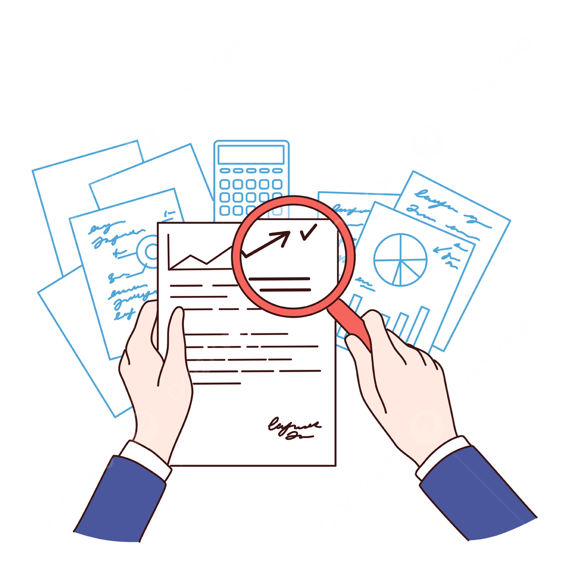
Factors Influencing EPLI Premiums
Business Size: Larger companies may face higher premiums due to increased risk.
Industry: Certain industries, like hospitality or healthcare, may carry higher risks and costs.
Claims History: A history of employment-related claims can result in higher premiums.
Employee Turnover: High employee turnover can increase the likelihood of claims, affecting premiums.
Policy Limits and Deductibles: Higher coverage limits and lower deductibles generally lead to higher premiums.
Notes:
Business Size: The size of a company often correlates with its risk exposure. Larger companies have more employees, which can increase the likelihood of employment-related claims. As a result, insurers may charge higher premiums to account for this increased risk.
Example: A large retail chain with over 500 employees faced a higher EPLI premium compared to a small boutique with only 10 employees. The larger employee base posed a higher risk of potential lawsuits, leading to the increased cost.
Industry: Certain industries inherently carry higher risks for employment-related claims due to the nature of their work environments or the demographics of their workforce. For example, industries like hospitality and healthcare may experience more claims related to discrimination or wrongful termination.
Example: A healthcare provider experienced a higher EPLI premium than a technology firm due to the higher incidence of employment disputes in the healthcare sector, such as claims of patient mistreatment or harassment among staff.
Claims History: A company's history of employment-related claims is a significant factor in determining EPLI premiums. A history of frequent or severe claims can indicate a higher risk, leading insurers to increase premiums to cover the potential for future claims.
Example: A manufacturing company that had previously settled several discrimination lawsuits saw its EPLI premiums rise substantially during renewal, as the insurer factored in the increased likelihood of future claims.
Employee Turnover: High employee turnover can be a red flag for insurers, as it may indicate potential issues with workplace culture, management practices, or employee satisfaction. High turnover increases the chances of claims related to wrongful termination, discrimination, or other employment practices.
Example: A call center with a high rate of employee turnover faced higher EPLI premiums because the constant influx and outflow of employees increased the risk of employment-related disputes.
Policy Limits and Deductibles: The selected policy limits and deductibles directly affect the cost of EPLI premiums. Higher coverage limits provide more protection but come with higher premiums, while lower deductibles reduce out-of-pocket costs in the event of a claim but also increase premium costs.
Example: A law firm opted for a high coverage limit on their EPLI policy to ensure they were well-protected in case of a lawsuit. This decision resulted in a higher premium compared to another firm that chose a lower coverage limit and a higher deductible to keep costs down.

Slide 8
Do Watch…
Visit without fail
What is EPLI ?
1: https://youtu.be/_M3yLjxNqjc?si=hQrxmEFF_AInZtSN
2: https://youtu.be/2JcSo37Nc8k?si=9-fE8eG_LedrILXp
3: https://youtu.be/UrtBiPgI__A?si=8BEci3IVGTPIanWg

